Slide 1
ClickCove - Ecommerce Website
Submitted by: Jaskirat Singh (2210990446)
Kartik Arora (2210990486) Jatin Jaglan (2210990458) Kartikey Bartwal (2210990492)
Submitted to: Dr. Baljit Kaur Mr. Vikas Patel

Slide 2
Outline
Introduction
Overview
Key Features
Steps to use it
Live Demo
Responsive Nature
Tech Stack
Objective
References
Conclusion

Slide 3
Introduction
ClickCove
Ecom Website:
Elevating E-Commerce with AI

Slide 4
Overview
ClickCove: Pioneering E-Commerce Innovation
Industry Leader: At the forefront of e-commerce advancements
Seamless Shopping: Provides a smooth and effortless shopping experience
AI Integration: Enhanced with state-of-the-art AI technology for superior service

Slide 5
Automated 95% of the e-commerce website
Customer Feedback Sentiment Classifier:
Uses DistilBERT to classify customer feedback sentiment.
Product Recommendation Engine:
Provides personalized product recommendations.
Automatic Dynamic Product Price Adjustment:
Adjusts product prices dynamically based on various factors.
Precise Future Sales Estimation:
Estimates future product sales accurately.
Multilingual Named Entity Recognition:
Recognizes and processes named entities in multiple languages.
Customer Acquisition and Maintenance:
Utilizes customer churn prediction to manage and retain customers.
Image Generative AI for Product Evolution:
Generates new product images for evolution and design purposes.

Slide 6
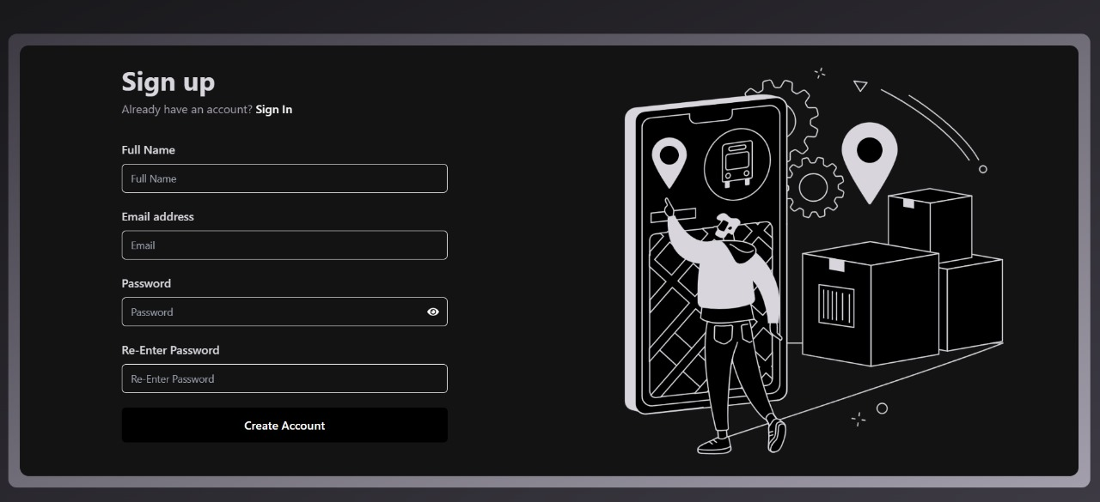
Live Demo
Sign up page : User can login by filling their inputs in the section provided.

Slide 7
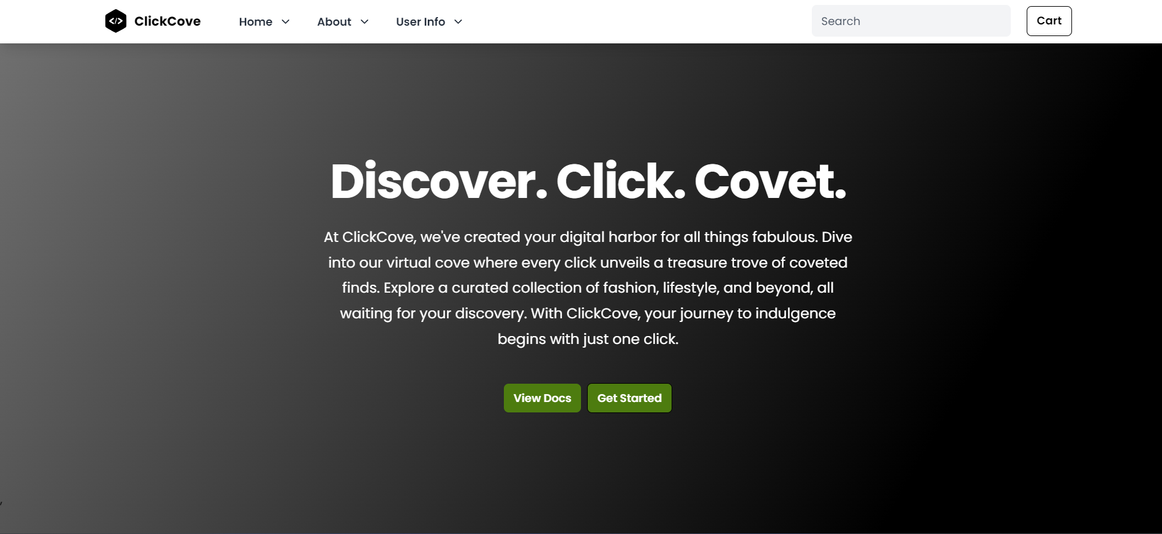
Home Page

Slide 8
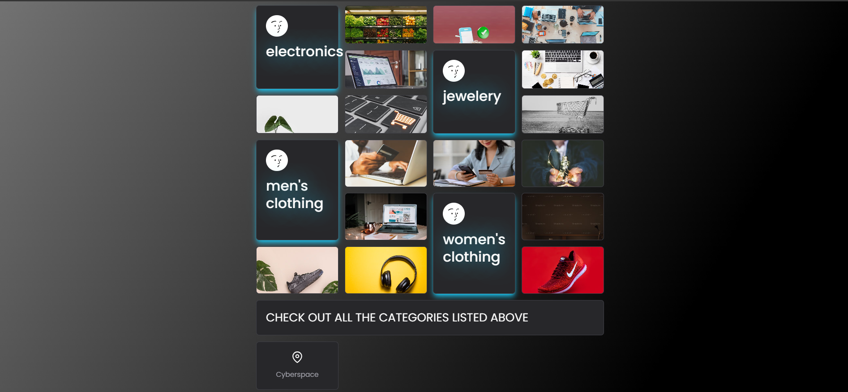
Responsive Nature
Home Page Continued.

Slide 9
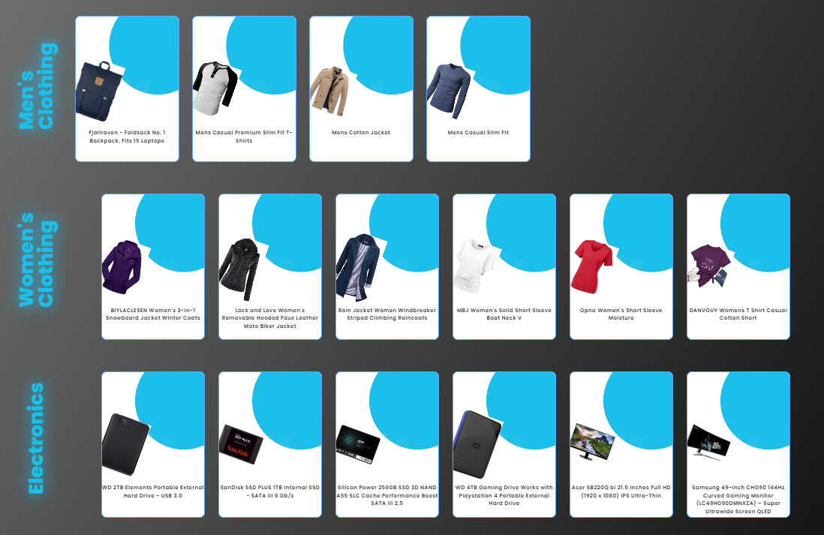
Product Tab

Slide 10
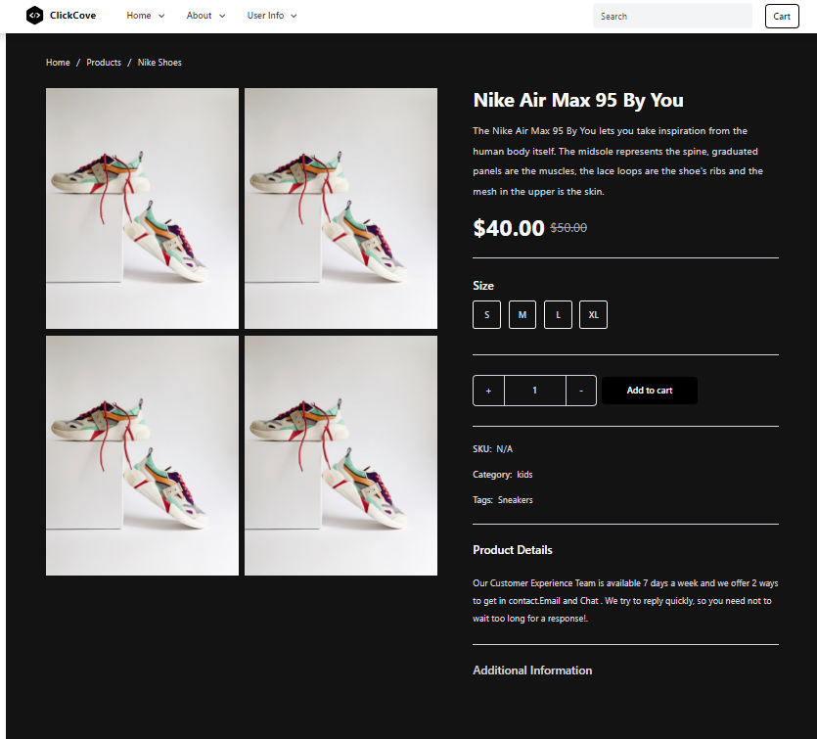
Product Tab

Slide 11
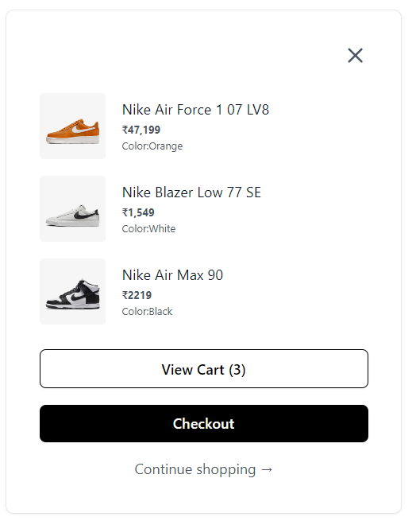
Checkout Feature

Slide 12
Tech Stack
Frameworks & Libraries:
- React: Dynamic and responsive UI
UI & Styling:
- Material-UI: Design components
- Styled-components: Scoped CSS-in-JS
Routing & Data:
- React Router: In-app navigation
Build & Deployment:
- Webpack & Babel: Module bundling and JavaScript compiling
- Netlify & Vercel: Hosting and continuous deployment

Slide 13
Objective
We are in the process of developing an ecommerce platform that provides personalized input and advanced research capabilities tailored to specific target users.
By enabling enhanced customer feedback and review mechanisms, our aim is to bolster overall sales performance.

Slide 14
References
HTML:
Official Documentation: HTML Living Standard
Tailwind CSS:
Official Documentation: Tailwind CSS Documentation
GitHub Repository: Tailwind CSS GitHub
React:
Official Documentation: React Documentation
GitHub Repository: React GitHub
Hover.css (hover.dev):
Official Documentation: Hover.css Documentation
GitHub Repository: Hover.css GitHub
Material-UI:
Official Documentation: Material-UI Documentation
GitHub Repository: Material-UI GitHub

Slide 15
Conclusion
Key Takeaways:
Emphasize the importance of user experience enhancements.
Highlight the significance of increasing conversion rates.
Stress the value of expanding market reach.
Encourage fostering deeper customer engagement.
Advocate for improving operational efficiency.

Slide 16
Thank You

